Slide 1
Predictive Modeling
Chapter 14: Classification Trees and Rule-Based Models
STA 6543
The University of Texas at San Antonio

Slide 2
Overview
Part I: General Strategies
Part II: Regression Models
Chapter 5: Measuring Performance in Regression Models
Chapter 6: Linear Regression and Its Cousins
Chapter 7: Nonlinear Regression Models
Chapter 8: Regression Trees and Rule-Based Models
Part III: Classification Models
Chapter 11: Measuring Performance in Classification Models
Chapter 12: Discriminant Analysis and Other Linear Classification Models
Chapter 13: Nonlinear Classification Models
Chapter 14: Classification Trees and Rule-Based Models

Slide 3
Tree-based classification models
Various types of tree-based classification models
Basic classification trees
Bagged trees
Random forest
Boosted trees
R demonstrations for the stock market data

Slide 4
Basic classification trees
Chapter 14: Classification Trees and Rule-Based Models

Slide 5
Overview
In Chapter 8, we discussed tree-based models for regression.
In this chapter, we study tree-based models for classification
Classification tree analysis: the predicted outcome is the class (discrete) to which the data belongs

Slide 6
Overview of a tree
Consider a classification problem that involves nominal data.
Data described by a list of attributes (e.g., categorizing people as short or tall using gender, height, age, and ethnicity)
How can we use such nominal data for classification?
How can we learn the categories of such data?
Nonparametric methods such as decision trees provide a way to deal with such data.

Slide 7
Overview of a tree

Slide 8
Pros and cons
Tree-based methods are simple and useful for interpretation.
However, they typically are not competitive with the best supervised learning approaches in terms of prediction accuracy.
We could use bagging, random forests, and boosting to grow multiple trees which are then combined to yield a single consensus prediction.
Combining a large number of trees can often result in dramatic improvements in prediction accuracy, at the expense of some loss interpretation.

Slide 9
rpart
CART (Classification and Regression Trees) is developed by Breiman, Friedman, Olshen and Stone
CART is the trademarked name of a particular software implementation of these ideas
tree() has been used in R
Hence, Recursive PARTitioning (rpart) was chosen
rpart has now become more common than the original and more descriptive “cart”
An introduction of rpart() can be found [here]
We look at the stock market data using rpart()

Slide 10
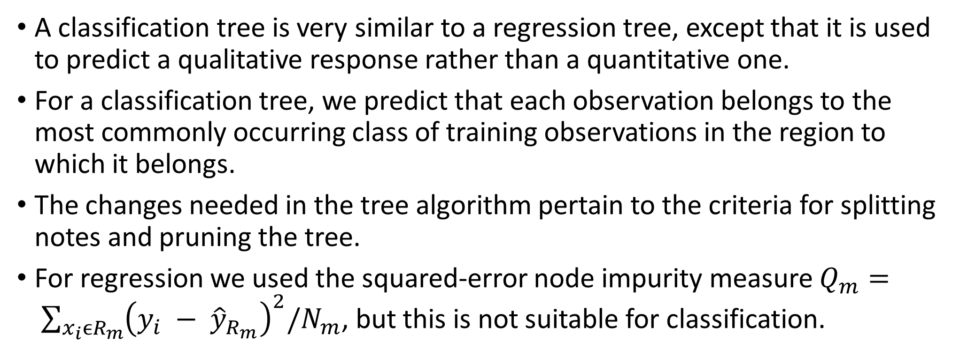
Classification trees
A classification tree is very similar to a regression tree, except that it is used to predict a qualitative response rather than a quantitative one.
For a classification tree, we predict that each observation belongs to the most commonly occurring class of training observations in the region to which it belongs.
The changes needed in the tree algorithm pertain to the criteria for splitting notes and pruning the tree.
For regression we used the squared-error node impurity measure $Q_{m}= \sum_{x_{i}{ϵR}_{m}}{{\left(y_{i} − {\hat{y}}_{R_{m}}\right)}^{2}/N_{m}}$, but this is not suitable for classification.

Slide 11
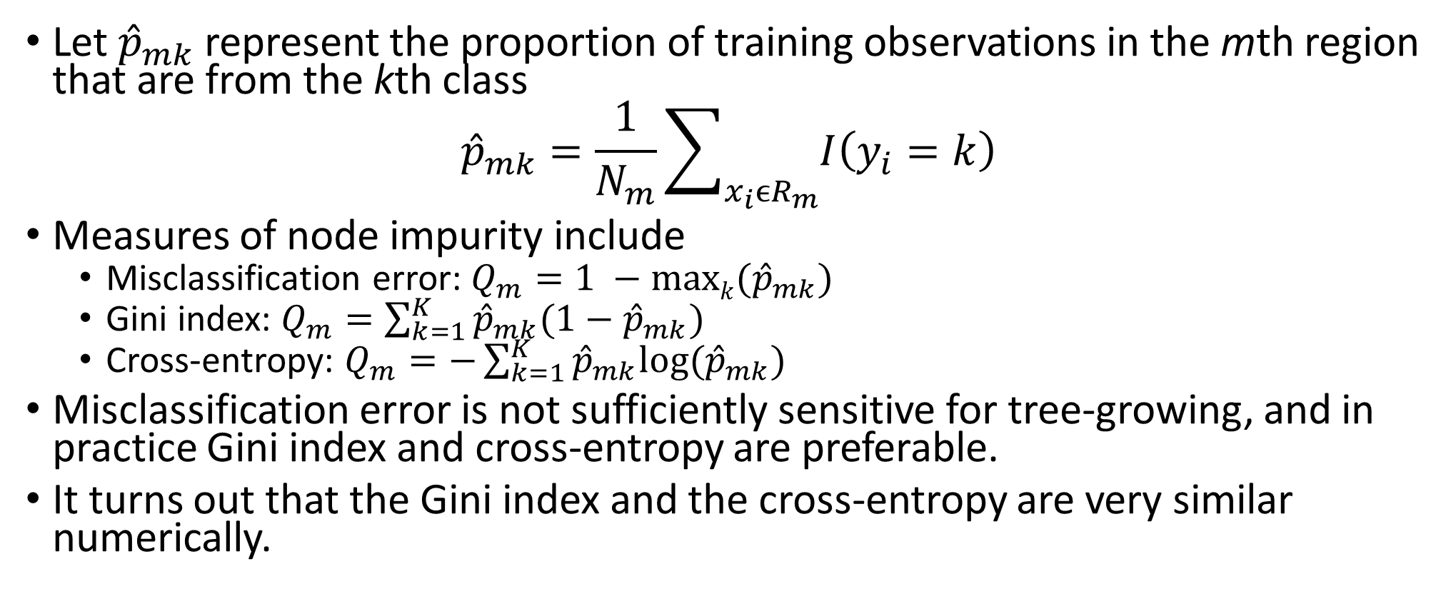
Node impurity measures for classification
Let ${\hat{p}}_{mk}$ represent the proportion of training observations in the mth region that are from the kth class
$${\hat{p}}_{mk}=\frac{1}{N_{m}}\sum_{x_{i}{ϵR}_{m}}{I\left(y_{i}=k\right)}$$
Measures of node impurity include
Misclassification error: $Q_{m}=1 −maxk({\hat{p}}_{mk})$
Gini index: $Q_{m}=\sum_{k=1}^{K}{{\hat{p}}_{mk}(1−{\hat{p}}_{mk})}$
Cross-entropy: $Q_{m}=−\sum_{k=1}^{K}{{\hat{p}}_{mk}log({\hat{p}}_{mk})}$
Misclassification error is not sufficiently sensitive for tree-growing, and in practice Gini index and cross-entropy are preferable.
It turns out that the Gini index and the cross-entropy are very similar numerically.

Slide 12
Summary of learning classification trees
Advantages
Easily interpretable by human (as long as the tree is not too big)
Computationally efficient
Handles both numerical and categorical data
Disadvantages
Finding partition of space that minimizes empirical error is NP-hard (nondeterministic polynomial hardness)
We resort to greedy approaches with limited theoretical underpinning
Unfortunately, trees generally do not have the same level of predictive accuracy as some of the other regression and classification approaches seen in this course.

Slide 13
Summary of learning classification trees
However, by aggregating many decision trees, using methods like bagging, random forests, and boosting, the predictive performance of trees can be substantially improved. We introduce these concepts in Chapter 8 for regression analysis.

Slide 14
The stock market data
# required packages library(AppliedPredictiveModeling) library(caret) library(rpart) library(ISLR) #the stock market data library(ipred) #bagging library(gbm) #boosting library(randomForest) #random forest #Access the data attach(Smarket) ###Data splitting train = which(Year<2005) Smarket.train= Smarket[train,]; # observations before 2005 are served as test data. Smarket.test= Smarket[-train,]; # observations from 2005 are served as test data.

Slide 15
A train control function
### Create a control function that will be used across models. set.seed(100) ctrl <- trainControl(method = "LGOCV", summaryFunction = twoClassSummary, classProbs = TRUE, savePredictions = TRUE) # LGOCV: Repeated Train/Test Splits Estimated (25 reps, 75%)

Slide 16
Classification trees
###############################Classification Trees############################# set.seed(476) rpartTune<- train(x = as.matrix(Smarket.train[,1:8]), y = Smarket.train$Direction, method = "rpart", tuneLength = 30, metric = "ROC", trControl = ctrl) rpartTune plot(rpartTune)

Slide 17
The tuning parameter

Slide 18
Bagged trees
###############################Bagged Trees######################################### set.seed(476) treebagTune <- train(x = as.matrix(Smarket.train[,1:8]), y = Smarket.train$Direction, method = "treebag", nbagg = 50, trControl = ctrl) treebagTune

Slide 19
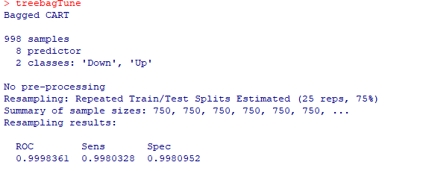
Bagged tree output

Slide 20
Boosting
###############################Boosting######################################### gbmGrid = expand.grid( interaction.depth = seq( 1, 7, by=2 ), n.trees = seq( 100, 1000, by=100 ), shrinkage = c(0.01, 0.1), n.minobsinnode = 10 ) set.seed(476) gbmTune <- train(x = as.matrix(Smarket.train[,1:8]), y = Smarket.train$Direction, method = "gbm", tuneGrid = gbmGrid, trControl = ctrl, verbose = FALSE) gbmTune plot(gbmTune, auto.key = list(columns = 4, lines = TRUE)) #variable importance gbmImp <- varImp(gbmTune, scale = FALSE) gbmImp

Slide 21
The tuning parameter

Slide 22
Variable importance

Slide 23
Radom forest
##########################Random Forest###################################### mtryGrid <- data.frame(mtry = 1:8) #since we only have 8 predictors ### Tune the model using cross-validation set.seed(476) rfTune <- train(x = as.matrix(Smarket.train[,1:8]), y = Smarket.train$Direction, method = "rf", tuneGrid = mtryGrid, ntree = 200, importance = TRUE, trControl = ctrl) rfTune plot(rfTune)

Slide 24
The tuning parameter (mtry = 6)

Slide 25
Prediction based on different models
### Predict the test set based on four models #Classification Trees Smarket.test$rpart<- predict(rpartTune,Smarket.test, type = "prob")[,1] #Bagged Trees Smarket.test$treebag <- predict(treebagTune,Smarket.test, type = "prob")[,1] #Boosting Smarket.test$Boosting <- predict(gbmTune,Smarket.test, type = "prob")[,1] #Random Forest Smarket.test$RF <- predict(rfTune,Smarket.test, type = "prob")[,1]

Slide 26
#ROC for Classification Trees RPARTROC <- roc(Smarket.test$Direction, Smarket.test$rpart) plot(RPARTROC, col=1, lty=1, lwd=2) #ROC for Bagged Trees TREEBAGROC <- roc(Smarket.test$Direction, Smarket.test$treebag) lines(TREEBAGROC, col=2, lty=2, lwd=2) #ROC for Boosting BoostingROC <- roc(Smarket.test$Direction, Smarket.test$Boosting) lines(BoostingROC, col=3, lty=3, lwd=2) #ROC for Random Forest RFROC <- roc(Smarket.test$Direction, Smarket.test$RF) lines(RFROC, col=4, lty=4, lwd=2) legend('bottomright', c('RPART','Bagged Tree','Boosting','Random Forest'), col=1:4, lty=1:4,lwd=2)

Slide 27
Roc curves of different models

Slide 28
Confusion matrices of different models
#Confusion matrix of Classification Trees confusionMatrix(data = predict(rpartTune, Smarket.test), reference = Smarket.test$Direction) #Confusion Matrix of Bagged Trees confusionMatrix(data = predict(treebagTune, Smarket.test), reference = Smarket.test$Direction) #Confusion matrix of Boosting confusionMatrix(data = predict(gbmTune, Smarket.test), reference = Smarket.test$Direction) #Confusion matrix of Random Forest confusionMatrix(data = predict(rfTune, Smarket.test), reference = Smarket.test$Direction)

Slide 29
Summary of output
Model | Accuracy | Kappa | Sensitivity | Specificity
Classification Tree | 0.5595 | 0.0000 | 0.0000 | 1.0000
Bagged Tree | 1.0000 | 1.0000 | 1.0000 | 1.0000
Boosting | 1.0000 | 1.0000 | 1.0000 | 1.0000
Random forest | 1.0000 | 1.0000 | 1.0000 | 1.0000

Slide 30
Model comparisons based on resamples of Training data
#Resamples of Tranining data res = resamples(list(RPART = rpartTune, BaggedTree = treebagTune, Boosting = gbmTune, RF = rfTune )) dotplot(res) #We can add the models from Chapters 12 and 13 res2 = resamples(list(Logistic = logisticTune, LDA =ldaTune,PLSDA = plsdaTune, Penalized = glmnTune, NSC = nscTune,QDA = QDATune, RDA =RDATune,MDA = MDATune, NB = NBTune, KNN = KNNTune, NN = NNTune, FDA = FDATune, SVM = SVMTune, RPART = rpartTune, BaggedTree = treebagTune, Boosting = gbmTune, RF = rfTune )) dotplot(res2)

Slide 32
Model comparisons from Chapters 12, 13, and 14

